Slide 1


A More Inclusive Internet: The New gTLD Applicant Support Program
Bringing Opportunity to Communities, Organizations, and Regions Around the World

Slide 2
Agenda
01
04
Overview of the
New gTLD Program:
Next Round
Assistance through the Applicant Support Program
02
Harnessing the Power of the Internet with a gTLD
05
Events and Resources
03
Becoming a Registry Operator
Notes:
Hello, my name is —-- Welcome to today’s _______, which we’ve developed to encourage your participation in the New gTLD Program: Next Round.
Here’s an agenda to share with you what we’ll be covering today.

Slide 3
Overview of the
New gTLD Program:
Next Round
01
Notes:
Let’s start with the reason we’re here today, to tell you about some interesting and exciting new opportunities that are about to happen with the launch of something called the New gTLD Program: Next Round.

Slide 4

The New gTLD Program
The New Generic Top-Level Domains (gTLD) Program is a community-driven initiative to enable the continued expansion of the Domain Name System.
Beginning in 2026, businesses, communities, governments, and other organizations can apply for new gTLDs tailored to fit their needs.
.онлайн
.dance
.charity
.futbol
.paris
.baby
.host
.公益
The number of gTLDs has grown to over 1,200.
.fast
.alibaba
.chase
.みんな
.com
.org
Notes:
The Internet started with just a handful of gTLDs. You’re probably most familiar with .com, .org, or .net.
As the Internet evolved, the number of gTLDs has increased. ICANN launched the New gTLD Program in 2012 to encourage innovation, competition, and consumer choice in the domain name industry. By the end of March 2021, there were more than 1,200 gTLDs.

Slide 5
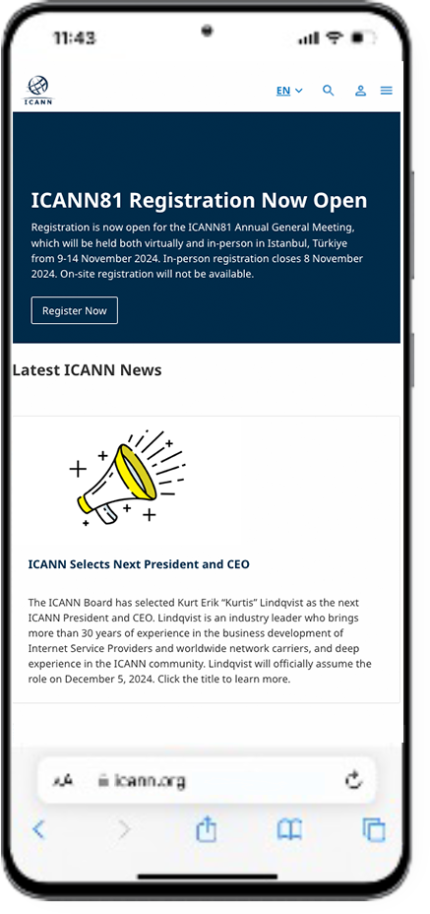
What is a gTLD?
Top-level domains form the last part of a domain name, appearing after the dot. For example, in the domain name icann.org, the characters ‘org’ identify the TLD.
Through the 2012 New gTLD Program, more than 1,200 new unique names like .trade and .vegas were added to the Internet.
ICANN's mission is to help ensure a stable, secure, and unified global Internet.
To reach another person on the Internet, you need to type an address – a name or a number – into your computer or other device. That address must be unique so computers know where to find each other.
Learn more
icann.org
Notes:
Top-level domains are the part of an Internet address that comes after the dot. New generic top-level domains, or gTLDs, can represent brands, communities, and geographies, as well as domain names in multiple scripts and longer than three characters. In certain scripts, the TLD appears to the left of the dot – like in Arabic.
Note: Without exception, all two-character TLDs are country-code domains, which indicate the country, sovereign state, or dependent territory where the website is based.
As the Internet evolved, the number of generic TLDs has increased to reflect the multidimensionality of billions of Internet users. ICANN has carried out three application rounds for new gTLDs: in 2000, 2004, and 2012.

Slide 6
Harnessing the Power of the Internet with a gTLD
02
Notes:
ICANN is preparing to open another round of applications for new gTLDs. But - what exactly do we mean by “applying for a new gTLD”? And why would an organization want to apply, let alone operate a gTLD?

Slide 7
New Domain Names, New Uses
EXAMPLES:
Serve diverse
cultural, geographic,
language, and professional communities.
Provide communities and organizations opportunity to create their own space online.
.photography
Industry-specific:
.rugby
.bank
playlist.new
Creative tools:
doc.new
Build trust in and awareness of a brand.
Manage and secure your online presence.
Location-based:
.durban
.nyc
Script-based:
.网址
شبكة.
Brands:
.google
.apple
Online identity:
.blog
Notes:
New gTLDs are intended to provide greater consumer choice and can be used in many innovative ways. For example, several brands are using a TLD for internal use to enable their employees and technical teams to set up secure spaces online.
.bank enhances trust in the online banking system by serving financial industries only and offering a secured, verified, easily identifiable location online.
.nyc was created to show the diversity of perspectives, people, and businesses that make New York the vibrant city that it is.
.new on the other hand can only be used to create a new task, like opening a new Google doc or a new Spotify playlist.
gTLDs can represent cultures, brands, geographies, communities, special interests, and more (e.g., .community, .london, .sport).

Slide 8
gTLD Opportunities
Connect and serve new groups:
Businesses and brands
Communities and cultures
Geographies
(e.g., cities and regions)
Governments – local and national - and IGOs
Targeted customers or members
Users of diverse scripts
Notes:
For businesses, a gTLD is a branding opportunity. And the opportunities are almost limitless, allowing individual businesses, commercial organizations, or entire sectors, to develop a unique label for themselves on the Internet.
New gTLDs will benefit people, businesses, and communities – from indigenous, religious, or linguistic communities, to companies and governments that want to address customers and constituents in local scripts, to communities that share a passion or commonality that are scattered throughout the world. These groups and entities have the opportunity to reflect their community, values, and geographic or cultural niches, via a new gTLD.

Slide 9
Benefits of Operating a gTLD
Brand management
Increased credibility
Control over policies
gTLDs provide organizations with the ability to make an impact on a global scale.
Monetization opportunities
Flexibility and creativity
Enhanced security
Localization
Notes:
In addition to having a unique “label” or name, a gTLD can offer many potential benefits:
Enhanced Security: An RO has the ability to implement security measures tailored to that domain, reducing the risk of cyber threats like phishing attacks.
Monetization Opportunities: An RO can sell domain names under the gTLD, potentially generating revenue.
Increased Credibility: A gTLD can enhance the credibility and trustworthiness of a brand in the eyes of users.
Brand Control: A gTLD gives you much more control over your brand online.
Flexibility and Creativity: As an RO, you can create domain names that are more relevant and creative for your specific niche or industry.
Control Over Policies: While some rules are set by ICANN Consensus Policies, an RO generally has the autonomy to set registration policies for the gTLD, including who can register domain names under your gTLD and for what purposes.
Localization: having your own gTLD can allow for localized domain names that cater to specific regions or languages, improving your global reach and relevance.

Slide 10
Becoming a Registry
Operator
03
Notes:
The process of applying to operate a registry business is much more complex than registering a domain name, which any individual or organization can do, and should not be entered into lightly. Applying for a new gTLD essentially means applying to operate an Internet registry. Let’s talk a little bit about what that entails.

Slide 11
Becoming a Registry Operator
Applying for a gTLD means you are applying to operate a piece of the Internet (a registry).
A registry supports all the domains registered under a particular gTLD.
A Registry Operator:
Sets the requirements for the gTLD.
Determines which second-level domains (the characters to the left of the dot) can be registered, and by whom.
Notes:
As an applicant, your organization is requesting to operate a registry that represents a part of the Internet infrastructure.
A registry is a database of all the domains registered under a specific TLD. Registry operators (ROs) maintain the master list or registry of all those domains. ROs have contracts with registrars that enable them to sell a gTLD. ROs also add, delete, or modify domain names and make other changes as requested by registrars.
The RO determines what organizations are allowed to register to use your domain and what organizations are not?
They also decide: What is the gTLD being used for? Is it a closed community like .bank or .edu or is it open?
Is it to be used only in a specific way, like .new? Or within a specific geography?

Slide 12
Financial and Technical Considerations
!
Applying for a new gTLD requires significant financial and technical resources.
New gTLD Program: Next Round expected evaluation fee: US $227,000
Standard operational fees included in the Registry Agreement signed with ICANN
Ongoing financial and technical obligations
!
All new gTLD applicants must be able to demonstrate the operational, technical, and financial capacities necessary to operate a registry and comply with contractual requirements.
*Fees subject to change
**Exceptions may apply for eligible applicants
Notes:
All new gTLD applicants must be able to demonstrate the operational, technical, and financial capacities necessary to operate a registry. Some of these operational and technical capacities, like back-end services, can be outsourced to third parties called Registry Service Providers.
But applying for a new gTLD requires financial and technical resources, including staff and equipment, that are out of reach for many.
The evaluation fee is expected to be 227,000 US dollars. More information is available in our fee FAQs available on the next round website.

Slide 13

Responsibilities of Registry Operators
Registry operators:
Responsibilities include:
Maintain master database of all domain names registered in the TLD.
Generate the "zone file" that allows computers to route Internet traffic to and from TLDs anywhere in the world.
Manage requirements detailed in the Registry Agreement and ICANN policies.
Convert domain names into IP addresses to enable routing of Internet traffic.
Operate the technical aspects of the TLD.
Notes:
There are many aspects – technical, financial, regulatory – to running a registry.
The registry operator plays a key role within the Internet ecosystem is to keep the master database of all domain names registered in each top-level domain and generate the "zone file" that allows computers to route Internet traffic to and from TLDs anywhere in the world.
Registry operators are responsible for maintaining the registry for each top-level domain. The responsibilities of the registries include accepting registration requests, maintaining a database of the necessary domain name registration data, and providing name servers to publish the zone file data (i.e., information about the location of a domain name) throughout the Internet.
Some registry operators may choose to outsource some of the technical requirements to a third party, called a registry services provider.
For people that would like to learn more about becoming a registry operator, you’re encouraged to take advantage of our ICANN Learn Course, which is available on icann.org.

Slide 14
Assistance for New gTLD Applicants
04
Notes:
The Applicant Support Program, or ASP, makes applying for a new gTLD more attainable to entities that are interested in running a gTLD but that need financial or training resources to do so.

Slide 15
Criteria for Applicant Support
To be eligible for assistance through the Applicant Support Program, applicants must demonstrate:
General business due diligence
Public responsibility due diligence
Financial need
Financial viability
Eligible entity status
Notes:
The evaluation criteria for qualifying include:
Business Due Diligence
Public Responsibility Due Diligence
Financial Need
Financial Viability
Eligible Entity Status
A complete guide to the ASP application process is available in the ASP Handbook - and we will talk more about this in a few minutes.

Slide 16
Applicant Support Program
Applying for a gTLD is expensive and may be out of reach for many. The Applicant Support Program makes applying for a new gTLD more accessible to entities that are unable to because of financial and other resource constraints.
Candidates must be one of these types of entities:
Nonprofit,
nongovernmental,and charitable organizations
Intergovernmental organizations
Indigenous/tribalpeoples’ organizations
Micro and small businesses that are social enterprises or that operate in a less-developed economy
Notes:
To apply to the Applicant Support Program, applicants must be one of these entities:
a nonprofit, nongovernmental, or charitable organization;
an intergovernmental organization;
an indigenous or tribal peoples’ organization;
or a small businesses that operates as a social enterprise or that is located in a less-developed economy.
Applicants need to certify to being one of the types of entities on this list and provide corresponding documentation.

Slide 17
Applicant Support Portfolio
The Applicant Support Program provides a range of financial and nonfinancial assistance to qualified, eligible entities.
Financial Support
A 75-85% reduction in applicable gTLD evaluation fees
Bid credit
Reduced/waived base registry operator fees
Nonfinancial Support
Training materials: applying for a gTLD, becoming a Registry Operator
Capacity Development/ Mentorship Program
Access to an Applicant Counselor
List of volunteer professional service providers
Notes:
For applicants that qualify for support, the program offers a range of financial and nonfinancial assistance to help applicants apply for a gTLD.
Financial assistance includes fee reductions (between 75-85% reduction) based upon available funds and the number of applicants that qualify for support.
75% is the minimum fee reduction for supported applicants; 85% is the maximum reduction for supported applicants.
It’s important to note there that fee reductions will apply to only one gTLD application per supported applicant.
Qualified ASP applicants that participate in contention resolution procedures in the new gTLD program will also be eligible to receive a bid credit.
Non-financial assistance includes access to training materials and resources, applicant counselors who can help support your application, and volunteer professional services.

Slide 18
Evaluating Support Applicants
PHASE 1
General business due diligence, including:
Legal compliance check.
Confirming that all required documentation has been submitted.
Confirming
the applicant meets eligibility criteria for New gTLD Program: Next Round.
Background screening and cybersquatting history check.
!
Applicants that do not pass the general business due-diligence
pre-screening will not be considered for Phase 2 evaluation.
Notes:
ASP evaluations will be conducted in two phases.
In the first phase, ICANN will conduct general business due diligence. This entails confirmation that the applicant is in legal compliance, that all required documents have been submitted, that the applicant is eligible for the New gTLD Program, as well as conducting background screening.
Applicants that do not pass this first phase of the evaluation cannot proceed to Phase 2.

Slide 19
Evaluating Support Applicants
PHASE 2
Evaluations conducted by third-party vendor managing a Support Applicant Review Panel:
Public responsibility
due diligence:
Applicant does not trade in, produce, or promote an industry/string contrary to generally accepted legal norms of morality and public order.
Applicant is not affiliated.
Financial need:
Applicant could not afford to apply to the New gTLD Program without financial hardship.
Financial viability:
Applicant demonstrates plan to cover remaining discounted portion of the base gTLD application fee and submits required deposit.
An approved entity that passes both phases may qualify for support.
Notes:
The second part of the evaluation process will be conducted by a Support Applicant Review Panel. Evaluation panelists will conduct fair, independent, efficient, consistent, and reliable evaluation processes to assess applicants.
The panel will review the remaining aspects of the evaluation criteria: public responsibility, which requires that the applicant does not trade in, produce, or promote an industry/string contrary to generally accepted legal norms of morality and public order. And that the applicant is not affiliated with an existing gTLD Registry Operator and/or another prospective gTLD applicant in the next round that would not meet the ASP criteria.
Additional requirements include financial need, financial viability, and confirming that the applicant is one of the eligible entities discussed earlier.

Slide 20
What Happens Next?
1
All new gTLD applicants – supported or not – are required to submit a completed application for a new gTLD.
2
Requires demonstration of technical, operational, and financial capabilities needed to operate a gTLD.
3
There are also measures in place to deter abuse of the program, outlined in the Applicant Support Program Handbook..
Notes:
It’s important to note that all applicants interested in applying for a new gTLDs must submit an application to the new gTLD Program. The New gTLD Program application submission will begin in early 2026. Applicants that apply for but do not qualify for support are still able to submit a gTLD application and pay the full fees. Applicants will need to meet the requirements for the gTLD program evaluation in order to be successful in their gTLD application. More information about the New gTLD Program is available on the website: https://newgtldprogram.icann.org/en

Slide 21
A Supported Applicant’s Journey
PHASES
Awareness
Understanding
Consideration
Great to
know there
is support for new registries!
EXPERIENCE
Excited we qualify for support!
How do we manage start-up costs?
What do we need to know to apply?
6
How is a gTLD relevant to our work?
5
gTLD Application Submitted
3
4
1
2
Applicant has applied & qualified
Communications,
outreach & engagement
Capacity Development Applicant Counselor
Pro Bono Services
SUPPORT
Notes:
The top bar shows phases people go through when they make an important decision–like applying for a gTLD. The bottom bar shows the support ICANN provides in each of those phases. In the middle, we provide an example of a supported applicant’s experience through these phases with these types of support.
So, here we see an applicant that’s making use of capacity development support, asking questions to the Applicant counselor, or using the volunteer professional services on offer. This journey continues on the next slide.

Slide 22
A Supported Applicant’s Journey
PHASES
Decision
Contracting & Delegation
Sustainable registry
Ready to launch!
10
gTLD Application Submitted!
Grateful for ongoing access to resources and the ICANN community.
9
8
EXPERIENCE
7
We have resources to help us get started.
Application counselors
and pro bono services helped us apply.
6
The application process was accessible and predictable.
Capacity Development Applicant Counselor
Fee Reductions
Mentorship
Applicant Counselor
Mentorship Reduced/Waived
Base RO Fees
SUPPORT
Notes:
This slide shows the continuation of the journey, where an applicant makes the decision to apply (top bar) and what support is available to them during and after the gTLD application process (bottom bar). This graphic shows the applicant’s journey through contracting and gTLD delegation, and the supports available long-term as the applicant becomes a registry operator.

Slide 23



Key Dates
NOV 2024
DEC 2025
APRIL 2026
Q3 2026
Applicant
Support Program
Application
Submission
Applicant
Guidebook
gTLD Application Submission
Application
submission period
for ASP (19 Nov 2024 - 19 Dec 2025*)
The Applicant Guidebook is a critical resource for the program and is estimated to be available in December 2025
Application submission period for new gTLDs expected to open in April 2026
*Organizational information must be submitted by 19 November 2025
Notes:
Here are some of the important dates you may want to make note of. The Applicant Support Program is open to receive applications now. For applicants that submit organization information by 19 November 2025, they will have until 19 December 2025 to submit their applications.
The final, Board-approved version of the AGB is estimated to be published in December 2025. The new gTLD program is expected to open to receive applications in April 2026.

Slide 24
Events and Resources
06

Slide 25
Upcoming Events
Stay up to date on all ICANN and Next Round events through the
ICANN Engagement Calendar.
Notes:
Presenter to add relevant events to this slide as needed.

Slide 26

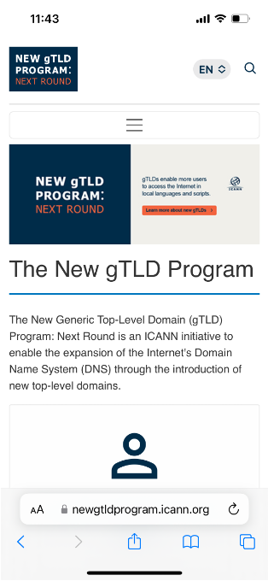
Stay Informed.
Join the Mailing List: nextroundinfo@icann.org
General inquiries: globalsupport@icann.org
Updates and news: https://newgtldprogram.icann.org

Slide 27
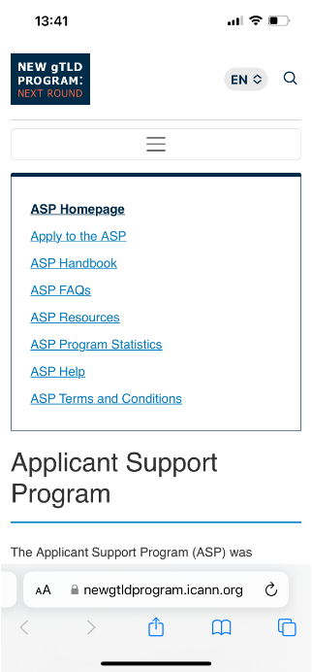
Helpful Resources for Support Applicants
OUTREACH AND ENGAGEMENT
Applicant Support Program Website
Applicant Support Program Handbook
Applicant Support Program IRT
Sub-Track Wiki Page
Background information on the Applicant Support Program
Use Cases of gTLDs
ICANN Learn Courses

Slide 28
Become a Next Round gTLD Program Champion
Convene and communicate in your own networks
Fully self-directed and voluntary
Utilize materials and resources developed by ICANN
Self-service Champions Toolkit to be published on newgtldprogram.icann.org under “resources”.
Toolkit (in six languages) to include:
Fact Sheets
Presentations
Options for available remote speakers
Notes:
If you’re interested in playing a role in the next round of new gTLDs - and we hope you are - consider being a Next Round Champion. Tell your colleagues about the opportunities on the horizon via the New gTLD Program, and the financial and non-financial assistance that’s available to support them.

Slide 29
Q&A

Slide 30
Thank You!
Visit us at https://newgtldprogram.icann.org

