Slide 1
2026 Round Applicant Journey
For all audiences
January 2026
Notes:
Facilitators:
https://docs.google.com/presentation/d/1YO23-O6G4-EmAEU23hF-stUnwpOjkGOm/edit?slide=id.g3ba5e3eea6d_0_93#slide=id.g3ba5e3eea6d_0_93

Slide 2


Welcome Message
Lars Hoffmann
VP, New gTLD Program Management and Deputy Program Lead

Slide 3
Readiness Content Disclaimer
The authoritative source for all information about New gTLD Program: 2026 Round rules, evaluations, restrictions, processes, and systems is the English version of the New gTLD Program: 2026 Round Applicant Guidebook. All New gTLD Program: 2026 Round readiness and training content is supplementary to the Applicant Guidebook, and has been developed to provide a high-level summary of key topic areas of interest to prospective applicants and the broader ICANN community. In case of discrepancy, the Applicant Guidebook prevails.

Slide 4
Welcome / Introduction
01

Slide 5
Agenda
01
Welcome / Introduction
✓Agenda and webinar objectives
02
Stages of the Applicant Journey
✓Overview of the gTLD application lifecycle and the key steps applicants must complete to move forward successfully
03
Resources and Next Steps
✓Overview of the key resources, learning pathways, and support available to help applicants prepare for the New gTLD Program: 2026 Round

Slide 6
Webinar Objectives
After completing this webinar, you should:
Know what is required to apply for a new generic top-level domain (gTLD) in the 2026 Round.
Have a clear overview of the stages and sequence of the application process.
Understand the purpose and outcomes of the activities and evaluations at each stage.
Recognize common concepts and terms related to the applicant journey.

Slide 7
Stages of the Applicant Journey
02
Overview of the gTLD application lifecycle and the key steps applicants must complete to move forward successfully.

Slide 8
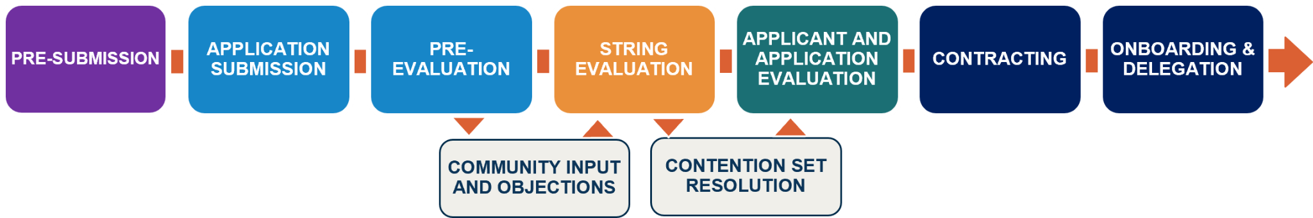

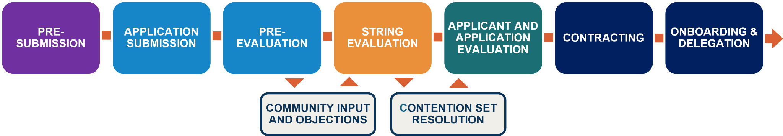
Applicant Journey Stages
WHY SUCH A ROBUST PROCESS?
To ensure the Internet remains secure, stable, and resilient as the Domain Name System (DNS) expands, while fostering innovation, competition, and consumer trust.

Slide 9
Back to Table of Contents
Pre-Submission
What applicants need to know before applying, from required expertise and documents to costs, risks, and system readiness.

Slide 10
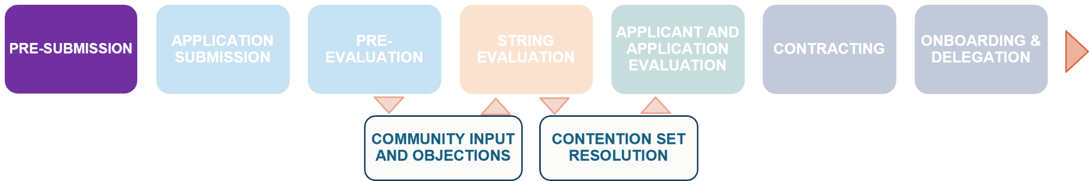



Requirements of a gTLD Application
Compliance Obligations and Legal Readiness
Cost Burden and Fee Requirements
Evaluations
Applicants must be a formed legal entity and agree to the program’s Terms and Conditions.
Applicants must pay the USD 227,000 gTLD Evaluation Fee (plus any conditional evaluation fees) within strict deadlines.
Eligible applications will undergo:
String evaluation.
Application and applicant evaluations, including financial and operational evaluation.
Background screening.
Any additional conditional evaluations that may be required.

Slide 11



Challenges Applicants May Face
Complexity and Timeline
Contention
Objections and Appeals
Technical Readiness and Infrastructure
The process includes multi-stage evaluation processes. Extensive documentation and evaluation occur over a multi-year timeline.
If two or more parties apply for the same string or confusingly similar string, ICANN forms contention sets and resolves them through community priority evaluation or an auction.
Filed by parties with standing. Objections can delay the process, push an application into contention, require modifications, or even prevent the application from moving forward. They can also result in significant financial fees.
Applicants must coordinate with and select an approved Registry Service Provider (See RSP Evaluation Program) that is approved to support the Registry Services that an applicant intends to offer.

Slide 12
Expertise Required
Assembling a multidisciplinary team is essential to address legal, technical, financial, and operational requirements.
Legal
Technical
IP law, domain name law, contract law (Registry Agreement), dispute resolution, regulatory compliance.
DNS operations, registry technical requirements, name collision mitigation, cybersecurity, infrastructure architecture.
Financial
Operational
Financial planning and projections, budget development, cost analysis, sustainability modeling.
Registry operations management, RSP selection, abuse handling procedures, customer support, business continuity.
Strategic
Policy & Governance
TLD strategy and positioning, market analysis, .brand management (.Brand TLDs), community engagement, competitive analysis.
ICANN policies, Internet governance, multi-stakeholder processes, public interest commitments, rights protection mechanisms.

Slide 13

Zoom Poll
Zoom Poll
Launch poll after this slide
Which area do you expect will be the most challenging?
Compliance Obligations & Legal Readiness
Cost Burden & Fee Requirements
Evaluations
Complexity & Timeline
Contention
Objections and Appeals
Technical Readiness & Infrastructure
Not sure yet

Slide 14
Information and Documents
Applications are comprised of three main sections:
SECTION 1 & 2
Organization and Financial Info
SECTION 3
gTLD Application Information
Core organizational entity and financial details required for all applicants when submitting their first application.
Includes:
System Users
Organization stakeholders & officers
Entity information and documentation
Financial information and documentation
Specific details for each application, including string information and operational plans.
Includes:
Applied-for string and optional replacement string and variants
Registry Service Provider selection / information
Supporting documentation
Required Elements
Review the Application Questions Appendix in the 2026 Round Applicant Guidebook for detailed information on required questions and documents.
Answers to questions listed in "Application Questions" section of the 2026 Round Applicant Guidebook.
Supporting documents as specified in documentation requirements.
System validation of all mandatory fields before submission allowed.
Required Elements

Slide 15
Financial Costs
Total costs include evaluation fees, conditional evaluation fees, and other fees, plus operational funding.
gTLD Evaluation Fee (per application)
Other Costs
USD 227,000
Conditional evaluations* (.Brand designation, Geographic Names, Reserved Names, Registry Commitments)
Objections and appeals (Dispute Resolution)
Approved change request may require re-evaluation and fees.
See section 3.3 Fees and Payments of the 2026 Round Applicant Guidebook for more information.
Exceptions:
Supported (ASP) applicants eligible for reduced fees.
Variant-only gTLD applicants meeting specific criteria.
*Required only if specific conditions are met.
Financial Sustainability: Applicants must demonstrate long-term operational funding capacity through Financial and Operational Evaluation.

Slide 16
Selecting an RSP
The RSP selection process ensures that new gTLDs are launched on secure, stable, and reliable infrastructure, maintaining trust in the global DNS ecosystem.
Applicants may choose pre-evaluated Registry Service Providers (RSPs) or seek ICANN approval to perform RSP functions themselves through the RSP Evaluation Program.
During completion of an application, applicants may designate one or more evaluated RSPs. Each gTLD requires an RSP.
RSP selection should be completed prior to Application and Applicant Evaluation to avoid delays.
While an applicant can submit its application without specifying the RSP, early selection is recommended to streamline application processing and avoid delays. RSP selection can be submitted via Application Change Request after application submission, but must be done prior to application evaluation in order to pass the evaluation.
The RSP program and selection of pre-evaluated RSPs is new in 2026.
NEW

Slide 17

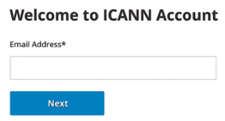
ICANN Account Creation
All applicant system users must create an ICANN Account to access the TLD Application Management System (TAMS) and begin the application process.
Applicants must designate 2 Primary TAMS users who can complete and submit the application, and optionally up to 5 additional users who can assist with drafting application content for the primary users to submit.
Place illustration or screenshot here
Secure login via your ICANN Account with multi-factor-authentication is required to ensure application information is secure.
Create an account at: https://account.icann.org/registeraccount

Slide 18
TLD Application Management System (TAMS)
TAMS
The secure online system used by applicants, ICANN, and evaluation panels to submit and manage new gTLD applications, monitor application progress, track payment information, communicate about a specific application, provide clarifications or request changes to your application content, and receive critical notifications related to applications.
Critical Notes
Application information must be submitted via the TLD Application Management System (TAMS).
Applications cannot be modified after submission except through the Application Change Request process.
Coming Soon:
System navigation webinars
Applicant System Guide
Micro-videos and/or simulations planned for some functionality

Slide 19
Back to Table of Contents
Application Submission and Pre-Evaluation
Overview of key submission requirements, timelines, validations, and early evaluation steps in the 2026 application process.
Notes:
Justin Start

Slide 20
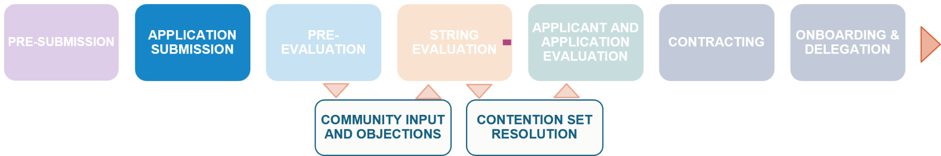
‹#›
Application Submission and Pre-Evaluation Timeline*
String Replacement Period
Prioritization Draw Event
Admin Check
String Confirmation Day
Application Submission (Begins 30 April 2026)
Reveal Day
April 2026
May 2026
June 2026
July 2026
Aug. 2026
Sep. 2026
Oct. 2026
Nov. 2026
Dec. 2026
Jan. 2027
*Dates are subject to change.
Date | Milestone
30 April 2026 – 12 Aug (15 weeks) | gTLD Application submission period opens for application info to be submitted via the TLD Application Management System (TAMS)
19 Aug 2026 | Evaluation fee payment window closes – 7 days after application period
Aug – Oct. 2026 | Admin Check
Projected Oct. 2026 | Reveal Day
Projected Oct.2026 | String Replacement Period - 14 days following Reveal day
Projected Nov. 2026 | String Confirmation Day
Projected Dec. 2026 | Prioritization Draw Event
Dates TBD until application volume is known

Slide 21

Concepts and Terms within Application Questions
Applicants benefit from familiarity with these terms to answer application questions completely and accurately.
NEW
Closed / Exclusive Generics
Replacement String
A TLD representing a string that is a generic name or term under which domains are registered and usable exclusively by the registry operator or its affiliates.
To potentially reduce the instances of contention, applicants are encouraged to designate a replacement string alongside their original choice of string. Applicants may designate only one replacement string per application. Applicant is able to submit a replacement string application that may contain different characteristics than its original choice of string.
Internationalized Domain Name (IDN)
Allocatable Variant Top-Level Domain (TLD) String
Domain names represented by characters other than the ASCII characters (letters a-z, for generic top-level domains) such as Arabic or Chinese.
A TLD string considered the “same” as the primary TLD and available for application along with the primary TLD, as determined by Root Zone Label Generation Rules (RZ-LGR). For example, a string in Traditional Chinese determined as an allocatable variant of a string in Simplified Chinese by RZ-LGR.

Slide 22
Application Question Flow
Black Font = Required Question Set for all applicants
Orange Font = Optional Question Set for all applications
Purple Font = Conditional Question Set required for specific applications or applicants
Pink Font = Required Question Set for all applications
Applying Entity Questions
Apply to all applications
Organization / Applicant
Applicant Entity Info: Set 1, Q1-48
Users: Set 2, Q49-64
Payments: Set 3, Q65-103
Applicant Background and Organization: Set 4, Q104-115
*Responses to Set 14 dictate the Financial profile questions an applicant will be required to answer

Slide 23
Application Question Flow
Black Font = Required Question Set for all applicants
Orange Font = Optional Question Set for all applications
Purple Font = Conditional Question Set required for specific applications or applicants
Pink Font = Required Question Set for all applications
Applying Entity Questions
Financial & Operational Questions
Apply to all applications
Answer questions according to applying entity financial profile
Organization / Applicant
Financial Profile Type*
Government Profile
Operational Questions
Applicant Entity Info: Set 1, Q1-48
Users: Set 2, Q49-64
Payments: Set 3, Q65-103
Applicant Background and Organization: Set 4, Q104-115
Set 15, Q192-194
Set 19, Q220-221
Financial Profile: Set 14, Q189-191
Registry Operator Profile
Set 16, Q195-201
Top 25 Financial Profile
Set 17, Q202-207
*Responses to Set 14 dictate the Financial profile questions an applicant will be required to answer
Standard Financial Profile
Set 18, Q208-219

Slide 24
Application Question Flow
Black Font = Required Question Set for all applicants
Orange Font = Optional Question Set for all applications
Purple Font = Conditional Question Set required for specific applications or applicants
Pink Font = Required Question Set for all applications
Applying Entity Questions
Financial & Operational Questions
Application Questions
Apply to all applications
Answer questions according to applying entity financial profile
Application Questions cannot be answered until applying entity and financial and operational questions are complete
Organization / Applicant
Financial Profile Type*
Government Profile
Operational Questions
Application Questions
Application & String Type
Community TLD Applications
Applicant Entity Info: Set 1, Q1-48
Users: Set 2, Q49-64
Payments: Set 3, Q65-103
Applicant Background and Organization: Set 4, Q104-115
Set 15, Q192-194
Set 19, Q220-221
Applied-for String: Set 5,
Q116-121
Variant String: Set 6, Q122-130
Safeguard Assessment / Mission & Purpose: Set 10, Q164-171
Registry Voluntary Commitments (RVCs): Set 11, Q172-175
Registry Services: Set 12, Q176-178
Additional Info and Supporting Material: Set 20, Q222
Bona Fide Intent / Prohibited Comms: Set 21, Q223-224
Volume Refund: Set 22, Q225
Community gTLDs: Set 7, Q131-157
Financial Profile: Set 14, Q189-191
Registry Operator Profile
Geographic Name TLD Applications
Set 16, Q195-201
Geographic Names: Set 8, Q158-161
Top 25 Financial Profile
Reserved Name Applications
Set 17, Q202-207
Reserved Names: Set 9, Q162-163
*Responses to Set 14 dictate the Financial profile questions an applicant will be required to answer
Standard Financial Profile
Brand Name TLD Applications
Set 18, Q208-219
.Brand TLD and Code of Conduct Exemptions: Set 13, Q179-188

Slide 25
Pre-Submission String Validations
Automated validations occur in the TLD Application Management System (TAMS) to ensure applied-for-string and variant-strings are eligible to be applied for.
Validation | What It Checks
Blocked Names | Identifies strings and variant strings on the Blocked Names list that cannot be applied for.
Reserved Names | Identifies protected names and their variant strings, reserved for specific entities (e.g., IOC, RCRC, IGO/INGO), triggering an exception process prompting the applicant to upload additional documentation.
DNS Stability | Assess whether the applied-for string complies with DNS and other relevant standards, including compliance with the Root Zone Label Generation Rules and the technical requirements specified for gTLD strings.
String Validation Challenge
If an applicant believes a string validation result was incorrect, they may file a Pre-Submission String Validation Challenge up to 14 days before the application window closes. ICANN’s Challenge Panel must respond within 5 days.

Slide 26
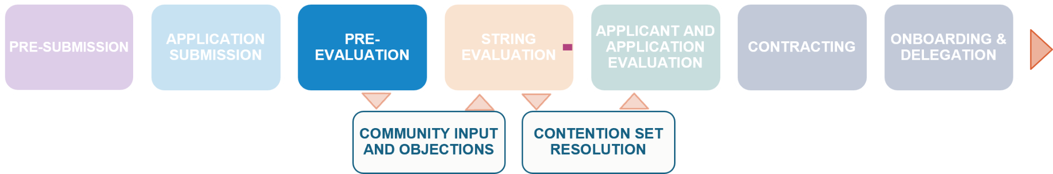
Pre-Evaluation Steps
During String Evaluation
Step 1
Step 2
Step 3
Step 4
Administrative Check
Reveal Day
Replacement Period
String Confirmation Day
Prioritization Draw
Purpose
ICANN verifies payment, then places identical applications in contention sets in preparation for Reveal Day.
Outcome
Applications passing check proceed to reveal day.
Purpose
Public application information is published.
Outcome
Applicants and public see applied-for strings and other public application information.
Purpose
Applicants may choose to replace their application with pre-submitted Replacement String application.
Outcome
Application avoids contention.
Purpose
Final applied-for strings and applications published. Initial list of contention sets updated.
Outcome
Community input period begins.
Purpose
Optional random draw assigns Priority Number for application processing.
Outcome
Establishes processing order.
1 day
1 day
1 day
8 weeks
14 days
String Evaluation
Pre-Evaluation phase will take longer than the events represented above to allow for ICANN processing time.
Community Input, Objections, and Appeals

Slide 27
Zoom Poll
Zoom Poll
Launch poll after this slide
Which part of the Pre-Evaluation process do you think plays the biggest role in shaping the rest of your application journey?
Reveal Day
Replacement String Period
String Confirmation Day
Prioritization Draw
Not sure yet
Notes:
Justin pass to Elisa

Slide 28
Back to Table of Contents
Community Input, Objections, and Appeals
Overview of the following processes: application comments, Governmental Advisory Committee (GAC) Member Early Warnings, GAC Consensus Advice, Singular/Plural Notifications, and objections and appeals.

Slide 29
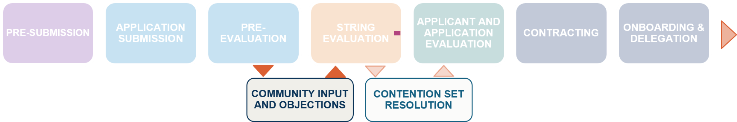
Concepts and Terms
Applicants benefit from familiarity with these terms related to Community Input, Objections, and Appeals.
Governmental Advisory Committee (GAC)
Dispute Resolution Service Provider (DRSP)
Provides advice on the activities of ICANN as they relate to concerns of governments, particularly matters where there may be an interaction between ICANN's policies and various laws and international agreements or where they may affect public policy issues.
Members of the GAC are comprised of national governments, multinational governmental organizations and treaty organizations, and public authorities.
An entity approved by ICANN to adjudicate objections and appeal proceedings.

Slide 30
Community Input, Objections, and Appeals
The ICANN community and interested members of the public have an opportunity to provide input on new gTLD applications after String Confirmation Day.
Application Comments
GAC Member Early Warning
GAC Consensus Advice
Singular / Plural Notifications
Objections
Purpose
Bring issues to the attention of ICANN, applicants and evaluators
Who?
Anyone
Duration
Opens on String Confirmation Day for duration of program. Comments within 104 days or 30 days of specific change requests available to evaluators
Outcome
No direct impact on applications but may be considered by evaluators
Purpose
Early indication that an application is potentially problematic for one or more governments
Who?
GAC Members and Observers
Duration
104 days
Outcome
No direct impact on application but signal that it could become subject of GAC Consensus Advice
Purpose
Provide advice to ICANN Board, including related to applications which are sensitive or violate national law
Who?
GAC
Duration
Any time
Outcome
The Board makes a decision
Purpose
Identifies if an applied-for string is the singular or plural form of another applied-for string, a delegated TLD, a string being processed from a previous new gTLD round, or a Blocked Name
Who?
Anyone
Duration
30 days
Outcome
Triggers Singular/plural Evaluation, may prevent application from proceeding
Purpose
Object to application on grounds of 1) String Confusion 2) Legal Rights 3) Limited Public Interest or 4) Community
Who?
Parties with standing
Duration
104 days
Outcome
Panel determination

Slide 31
Back to Table of Contents
String Evaluation
Evaluation of each applied-for string for similarity, stability, safeguards, geographic rules, and name collision risk.

Slide 32
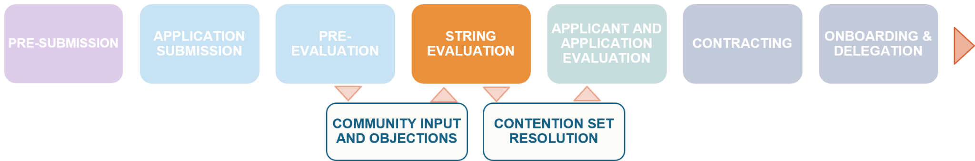
Concepts and Terms
Applicants should be familiar with these terms related to String Evaluation.
Safeguard Public Interest Commitments (PICs)
Temporary Delegation
Applied-for strings that are not identified as high-risk of name collision are temporarily delegated to DNS nameservers managed by ICANN to collect data about the volume and nature of DNS traffic for that string.
An addition to a registry operator’s Base Registry Agreement which is required to protect the interests of a specific group, including consumers, regulated sectors, industries requiring licensing or accreditation, government functions, or protecting against cyber bullying or harassment.
Name Collision
Refers to the situation in which a resource name that is intended to be resolved in one naming system is inadvertently resolved in a different naming system, potentially leading to unexpected behavior such as communication being disrupted or redirected from its intended recipient
Note:
12/15 - Additional SME input has been requested.

Slide 33
Summary of String Evaluation
String Evaluation ensures that each applied-for string is technically sound, safe, and compliant with policy.
Geographic Names Identification
Singular/Plural Notification Eval.
String Similarity Evaluation
Safeguard Assessment
Name Collision Initial Assessment
Purpose
Confirms whether applied-for strings are geographic names.
Applies to?
All applications
Outcome
Three possibilities 1) Geographic Name Review, 2) no additional evaluation, 3) application shall not proceed
Purpose
Determines if an applied-for string represents the singular or plural form of the same word in the same language as another applied-for or delegated TLD. The evaluation is conducted against materials submitted by the notifier.
Applies to?
Applications flagged with a singular/plural notification
Outcome
Three possibilities 1) No impact, 2) Contention 3) Application termination
Purpose
Identifies if any applied-for string is visually similar to any existing TLDs or Blocked Names or with any other applied-for strings.
Applies to?
All applications
Outcome
Three possibilities 1) No impact 2) Contention 3) Application termination
Purpose
Determines if an applied-for string requires safeguard public interest commitments in their Registry Agreement to protect specific groups, industries, or governments.
Applies to?
All applications
Outcome
Two possibilities 1) Assign safeguard public interest commitments to application, 2) No impact
Purpose
Identifies applied-for strings at high risk of name collision.
Applies to?
All applied-for strings
Outcome
Three possibilities 1) Proceed to temporary delegation 2) Applicant submits Mitigation Plan for Evaluation during Application Evaluation 3) Application does not proceed

Slide 34
Back to Table of Contents
Contention Set Resolution
Overview of how contention sets are resolved, including available resolution paths.

Slide 35
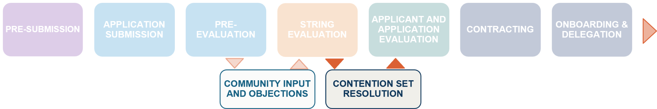



Contention Set Resolution Overview
What it is?
Types of Contention
How is it resolved?
Direct = two strings are identical or confusingly similar (bear and beer)
Indirect = a third string is confusingly similar to one but not both/all strings in an existing contention set (bear and beer are in direct contention; bear and pear are in direct contention, beer and pear are in indirect contention).
Two or more applied-for strings are either identical or found to be confusingly similar.
Contention Sets are formed through:
Application for identical strings
Singular/Plural Notification
String Similarity Evaluation
String Confusion Objection
Community Priority Evaluation (Community applications)
Auction
Note: .Brands can potentially avoid contention by initiating a .Brand String Change.
i
i
Confusingly similar visually, aurally, or in meaning to an existing TLD and/or another applied for primary gTLD string

Slide 36

Resolution Types
Types of Resolution:
.Brand String Change: Allows .Brand applicants to change their applied-for string by adding a trademark-related term to avoid contention without creating new or expanded contention sets.
Community Priority Evaluation (CPE): Allows a community-based applicant to prevail over others by demonstrating strong community support and adherence to defined eligibility criteria. However, If multiple Community Applications for the same string pass the CPE, they remain in contention.
Auction: If neither option applies, an auction will be conducted where the highest bidder wins the right to proceed.
Auction Details:
Auctions are ascending-clock style and managed by an external provider.
After the auction concludes, the prevailing applicant pays the second-highest bid price, and non-prevailing applicants may withdraw their application.
Note that applicants in contention are prohibited from discussing or negotiating settlement agreements or post-auction transfer arrangements with another applicant.

Slide 37
Back to Table of Contents
Applicant and Application Evaluation
Overview of how ICANN evaluates the applicant and the application to ensure operational, financial, and technical readiness.
Notes:
Grant

Slide 38
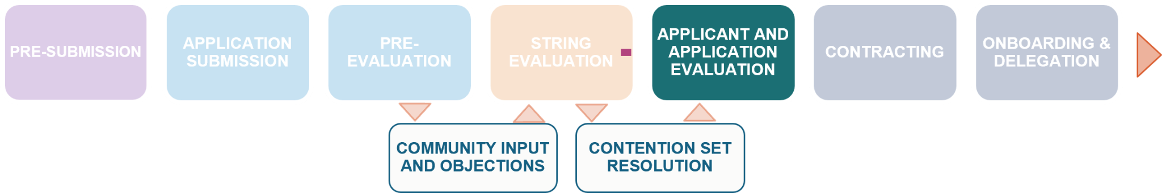



Applicant Evaluations
Both evaluations are mandatory for all applicants
Background Screening
In place to protect the public interest in the allocation of critical Internet resources by ensuring that only established corporations, organizations, or institutions in good standing are eligible to become a registry operator.
ICANN reserves the right to deny an otherwise qualified application based on findings from the background screening process.
Change Requests which alter organization or applicant information may trigger the need for an additional background screening.
Financial and Operational Evaluation
Assesses whether an applicant has the financial capacity to fund the registry long-term, thereby ensuring DNS stability, and mitigating financial risks like revenue shortfalls or cost overruns, including for those managing multiple TLDs.
Notes:
Grant

Slide 39
Types of Application Evaluations
Registry Service Provider Review verifies whether the applicant has selected one or more evaluated RSPs as part of its application. This is mandatory for all applications.
Note:
12/15 - Additional SME input has been requested.
Geographic Names Review verifies supporting documentation for any application for an eligible Geographic Name.
Reserved Names Review determines whether the appropriate organization has applied for the reserved name and will verify the supporting documentation
.Brand TLD Eligibility Evaluation has the purpose to assess whether the applicant meets the criteria for a .Brand TLD designation
Variant String Evaluation assess the justification for each applied-for variant string
operator’s own use or for use by its affiliates
Name Collision High-Risk Mitigation Plan Evaluation reviews Plan for strings that were deemed to present a high risk of Name Collision
Registry Operator Code of Conduct Exemption Evaluation is for applicants proposing to register all domain names in the gTLD exclusively for the registry
Registry Commitments Evaluation assesses RVCs and/or Community Registration Policies proposed by the applicant for inclusion in the registry agreement.
Notes:
Ariel

Slide 40
Back to Table of Contents
Extended Evaluations and Challenges
Overview of Extended Evaluations and Challenges.
Notes:
Ariel

Slide 41



Extended Evaluation
Purpose
Provides additional time and interaction to address outstanding concerns regarding a specific evaluation.
Process & Timing
Evaluations Subject to Extended Evaluation
Applicants may request extended evaluation within 15 days of notification of their Application and Applicant Evaluation results.
Extended evaluation is conducted by the same set of evaluators who initially conducted the relevant evaluation.
Applicants respond within set time frame; duration varies by evaluation type.
Where applicable, an evaluation panel may issue additional clarifying questions as part of extended evaluation
Background Screening
Financial and Operational Evaluation
Registry Service Provider Review
Geographic Names Review
Reserved Names Review
Variant String Evaluation
Notes:
Ariel

Slide 42
Evaluation Challenge
Purpose
Allows applicants to challenge their own evaluation result based on claims of procedural, factual, or system error in the automatic validations run by TAMS that may have led to an incorrect evaluation outcome.
Process & Timing
Evaluations Subject to Evaluation Challenge
Applicants can provide documentary evidence.
Applicants are not allowed to submit any new information that could constitute a material change.
Evaluation challenges generally do not provide for clarifying questions.
Evaluation challenges are subject to a “quick look” assessment.
Pre-Submission String Validations
String Similarity Evaluation
Singular/Plural Notification Evaluation
Community Priority Evaluation
Name Collision High-Risk Mitigation Plan Evaluation
Notes:
Grant

Slide 43
Back to Table of Contents
Clarifying Questions
Overview of Clarifying Questions
Notes:
Ariel

Slide 44


Clarifying Question Management (Evaluator Questions)
During evaluation, the evaluator may issue a clarifying question to an applicant to help it understand or verify information.
When do they occur
Response Requirements
During each Application and Applicant Evaluation, as well as Community Priority Evaluation, the evaluation panel may issue clarifying questions when:
Additional information is needed to complete their review;
An applicant is at risk of failing; or
Application comments may affect the evaluation.
To respond, applicants will have:
7 days for administrative questions
21 days for substantive questions
Notes:
Ariel

Slide 45
Back to Table of Contents
Contracting - 2026 Base Registry Agreement
Overview of Contracting

Slide 46
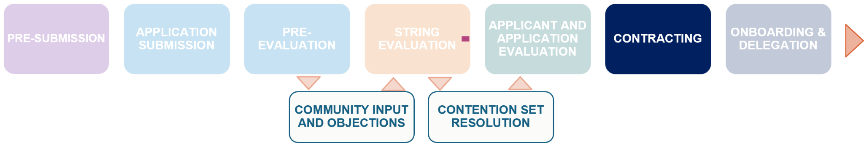

Contracting - 2026 Base Registry Agreement
Successful New gTLD Program 2026 Round applicants will be required to sign the *2026 Base RA to operate the TLD
Overview
The Registry Agreement (RA) defines the rights, obligations, and responsibilities for the RO to operate a TLD.
Must be executed within 90 days of ICANN's invitation to contract.
All registry operators must delegate their TLD within one year from the date of Registry Agreement execution.
The latest draft of the 2026 Base RA can be found on the New gTLD Program: Next Round website
What does the 2026 Base gTLD Registry Agreement include?
The operational criteria to ensure compliance with ICANN policies;
The core obligations of the RO to operate a TLD, the core obligations of ICANN, the term and termination provisions, fees, amendment process, and special provisions;
Specifications that clearly define the responsibilities, technical and operational standards, and obligations that registry operators must follow to ensure the stable and secure operation of TLDs within the Domain Name System (DNS).
Of note: Specification 12 (Community TLDs), Specification 13 (.BRAND TLDs), Specification 14 (Variant TLDs)
*The anticipated review of the proposed 2026 Base RA by the ICANN Board will be in March 2026 at ICANN85.
Notes:
Trademark Clearinghouse Requirements (“TMCH Requirements”)
The TMCH Requirements are linked to in Specification 7 of the RA
Updates to be incorporated:
Implementing RPM Phase 1 PDP recommendations
Technical updates (e.g. updated links and terminology)
Public Comment 18 December 2025 - 27 January 2026
Specification 14: Following the ICANN Board’s action on IDN EPDP Phase 1 Recommendations 7.4 and 7.5, ICANN posted a separate public comment proceeding to Specification 14. Public comment: 10 December 2025 - 27 January 2026

Slide 47
Back to Table of Contents
Onboarding and Delegation
Overview of the onboarding and delegation process.

Slide 48
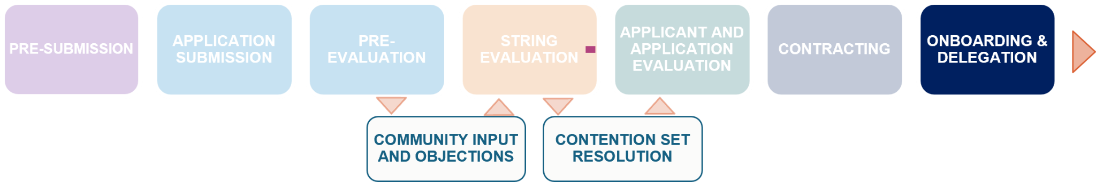

Onboarding and Delegation (Overview)
Component 1
Component 2
Component 3
Onboarding
Pre-Delegation Testing (PDT)
Delegation to the Root Zone
What is it?
Registry operators must complete onboarding activities for ICANN’s systems and processes, including:
collection of registry contacts and technical information to setup registry processes required by the Registry Agreement.
What is it?
The purpose of the PDT is to verify that the registry operator has met its commitment to establish registry operations in accordance with the technical and operational criteria required in the 2026 Registry Agreement.
Each TLD will be required to complete PDT as a prerequisite to delegation into the root zone.
What is it?
The process through which the TLD is delegated into the root zone, which considers working with IANA. The new gTLD becomes active in the DNS and is available for public use.
Other Components
Setup and testing of Trademark Database (TMDB) access and use
Establish Sunrise, Claims, and other Launch periods for TLD
ICANN provides detailed guidance and training to contracted parties throughout the process, via the GDD Accounts and Services Team.
Notes:
Collection of Registry contacts, and technical
information to setup registry processes
required by the Registry Agreement
• Completion of Pre-Delegation Testing (PDT)
• Setup and testing of Trademark Database (TMDB) access and use
• Establish Sunrise, Claims, and other Launch periods for TLD

Slide 49
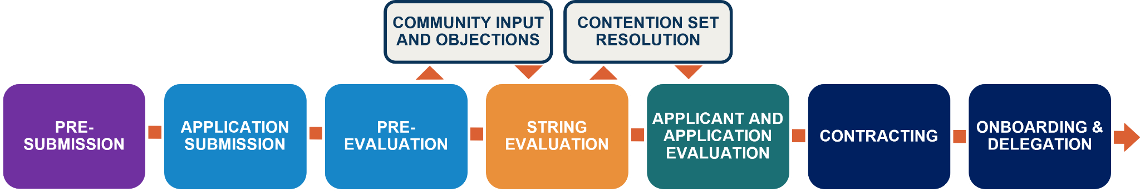
Recap of the Applicant Journey
ICANN facilitates resolution of contention between applications for strings which are identical or a variant of another applied-for string or similar visually, aurally, or in meaning.
General public and specific groups with standing provide feedback about specific applications.
Applicant assembles documentation and plans required to respond to application questions.
ICANN evaluates the applied-for string and its allocatable variant strings to ensure they are technically sound, safe and compliant with policy.
Successful applicants sign a Registry Agreement.
Applicant submits responses to organization, financial, and application questions and pays the gTLD evaluation fee.
ICANN evaluates applicant and application information from an operational and financial standpoint.
New contracted parties complete onboarding to ICANN systems and processes and technical testing before the gTLD is operational.
ICANN publishes public application information on Reveal Day, then opens the String Replacement Period for eligible applicants. On String Confirmation Day ICANN publishes the final list of applied-for strings. Finally, the Prioritization Draw establishes the order in which applications are processed.

Slide 50
Resources and Next Steps
03
Key applicant resources and next steps to stay informed and prepared throughout the 2026 application process.

Slide 51
Key Applicant Resources
New gTLD Program: 2026 Round Applicant Guidebook The authoritative document outlining the rules and procedures of the 2026 Round.
New gTLD Program: 2026 Round Website Source of 2026 Round news, announcements, information, and resources. | ICANN Learn eLearning courses to build knowledge of ICANN and the DNS Industry.
Applicant Readiness Pathway Curated learning resources organized by phases and learning outcomes (coming soon) | 2026 Round FAQs Frequently asked questions, organized by category.
ICANN Global Support Dedicated ICANN team available to answer inquiries and provide support throughout the application process. globalsupport@icann.org | New gTLD Program Webinars Register for future webinars, or access recordings of past events.

Slide 52
Question and Answer
Questions pre-submitted to the ICANN Global Support Team will be answered first, then Q&A questions from the audience will be answered.
Themes:
Context / background
Processes, procedures, roles, and responsibilities
Support and resources
Q&A
Submit further questions to: globalsupport@icann.org
Notes:
Pre-Submitted questions.
https://docs.google.com/spreadsheets/d/1GkSbDm6MTXRInysvb7ET5h_bP1QUgHRwFdRDftC0xWY/edit?gid=0#gid=0

Slide 53
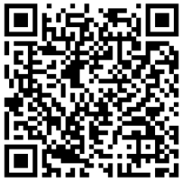
Evaluation Survey
We kindly request you to take a few minutes to complete this brief feedback form.
Survey
https://app.smartsheet.com/b/form/6f887484b05942ae8206e6c68b9e6578

Slide 54
Thank you for your participation.
Visit us at https://newgtldprogram.icann.org

